Slide 1
Website Content

Slide 2
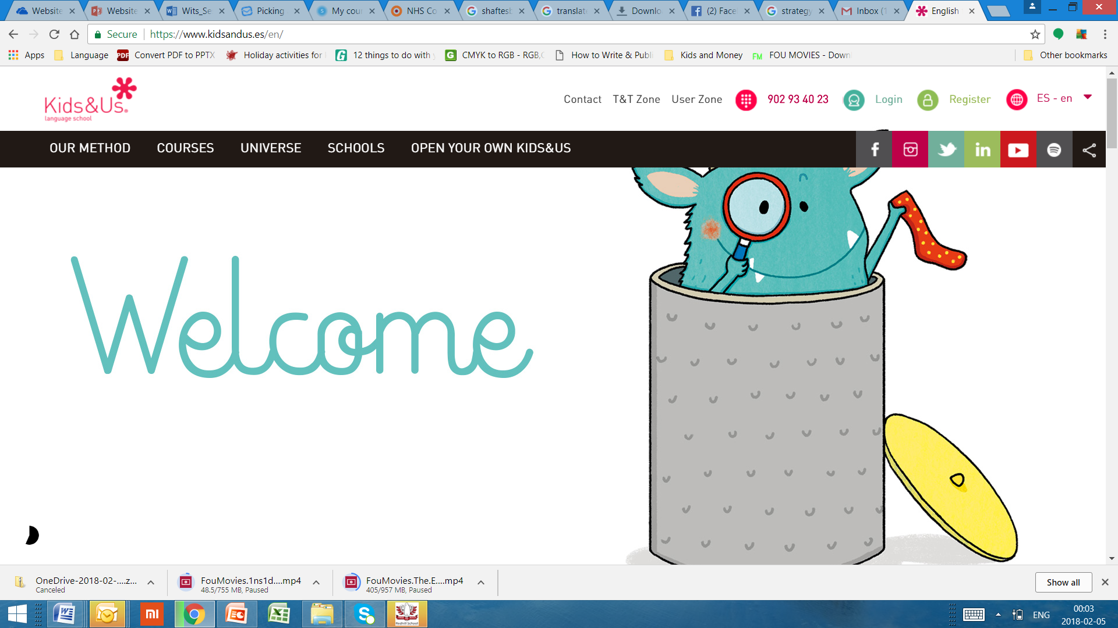
Home page 1
Enrol/Sign Up
Connect with Us
Why African languages
Courses
Universe
Links
Boost your linguistic universe with African languages
Active Classes | Key Facts about Rera | Language Learning as an Extracurricular | Complete Our Survey and Get a Trial Lesson
Language acquisition through talks, song, dance and other activities to keep students engaged (more..our methodology) | Immersion approach with minimal English used Fun activities for all ages In person and online courses for children and adults In person and online Sesotho lessons started for children and adults isiZulu and chiShona to begin in June and more to come over time Integrated communication skills together with music, arts and craft Regular feedback on progress (more…programs) | Learning a heritage or second language helps with social skills , self-esteem, and creating connectedness with others Wider cultural understanding through immersion in an language and designed cultural activities Greater opportunity for communication in the communities we live in or visit Multilingualisam is a norm in South Africa as in most other countries (why languages) | Help us understand your needs better and receive a trial lesson in isiZulu, chiShona or Sesotho for yourself or your child 10 minute long questionnaire Opportunity to pre-register for upcoming courses (more…survey)

Slide 3
Home page 2
pic
pic
pic
pic
Children
Adults
Tutoring
Online
Rera offers children’s classes from age 3 upwards, as an extramural and Saturday school programme
(read more: programs for children)
Group and individual classes at beginner to advanced levels
(read more: programmes for adults)
Tutoring focused on achieving proficiency and following set curiculum at schools
(read more: tutoring)
One-on-one lessons for children (over 6) and adults whose schedules or locations do not allow them to come to a class (read more: online classes)

Slide 4
Home page 3
Our universe
We believe it is important for language to be experienced beyond the classroom through complementing activities and home practice. Rera offers language play dates where children can meet and have supervised play in their target languages. We also offer monthly storytelling in Sesotho, isiZulu and chiShona which allow young and old to enjoy language in a greater form. (Read more: our universe)

